Slide 1
Data-Driven Marketing: Campaign Performance Analysis & Insights
Table of contents :
INTRODUCTION- Overview and objectives of the analysis.
FINDINGS - Insights and key observations from the analysis.
METHODOLOGY AND VISUALIZATION
RECOMMENDATION - Strategies to optimize marketing campaigns.
CONCLUSION

Slide 2
INTRODUCTION
Dataset Overview(Marketing_campaign_dataset). The dataset as provided by HNG contains marketing campaign performance data, including metrics such as Click-Through Rate (CTR), Cost Per Click (CPC), Return on Investment (ROI), and Conversion Rate. It also includes campaign details like marketing channel, campaign type, and customer demographics.
The key performance metrics analyzed include:
Impressions: The number of times an ad was displayed.
Clicks: The number of times users clicked on an ad.
CTR (Click-Through Rate): The percentage of impressions that resulted in clicks.
CPC (Cost Per Click): The average cost per ad click.
Conversion Rate: The percentage of users who completed a desired action.
ROI (Return on Investment): The profitability of the campaign.
Marketing Channels: Different platforms used (Social Media, Email etc).
Analysis Objectives:
Understand key performance metrics for different campaigns.
Identify high-performing and low-performing campaigns.
Analyze channel effectiveness (CTR, CPC, and ROI).
Detect outliers and trends that affect marketing success.
Provide actionable recommendations to optimize campaign performance.

Slide 3
FINDINGS AND INSIGHT
1. Campaign Performance (High vs Low Performing)
🔹 Campaigns were classified into high-performing and low-performing based on median ROI. 🔹 High-performing campaigns had higher CTR and lower CPC, making them more cost-effective.
2. Marketing Channel Effectiveness
🔹 Social Media & Email Marketing had the highest CTR, showing strong audience engagement. 🔹 Paid Search campaigns had higher CPC but better conversion rates, indicating a high ROI potential.
3. Outliers & Spending Trends
🔹 Boxplot analysis revealed that some campaigns had extremely high CPC but low ROI, signaling wasted ad spend. 🔹 Seasonal trends influenced performance, with some channels performing better during specific timeframes.

Slide 4
METHODOLOGY AND VISUALIZATION
Data Cleaning
Loaded the dataset to inspect its structure.
Checked column names, data types, and missing values.
Key columns identified: Campaign_ID, ROI, Clicks, Conversion Rate, CPC, Channel_Used.
Converted Date column to datetime format. df['Date'] = pd.to_datetime(df['Date'])
Created new calculated columns:
CTR (Click-Through Rate) = (Clicks / Impressions) * 100. df['CTR'] = (df['Clicks'] / df['Impressions']) * 100
CPC (Cost Per Click) = Acquisition Cost / Clicks. df['CPC'] = df['Acquisition_Cost'] / df['Clicks'].replace(0, 1)
Checked for inconsistencies in categorical columns.
Used df.describe() to analyze key numerical fields
Used boxplots to detect outliers in Clicks, Impressions, CPC, and ROI.
Grouped data by Channel_Used and calculated:
Avg CTR, Avg CPC, Avg ROI, Total Clicks, and Total Impressions. =df.groupby("Channel_Used").agg(
Avg_CTR=("CTR", "mean"),
Avg_CPC=("CPC", "mean"),
Avg_ROI=("ROI", "mean"),

Slide 5
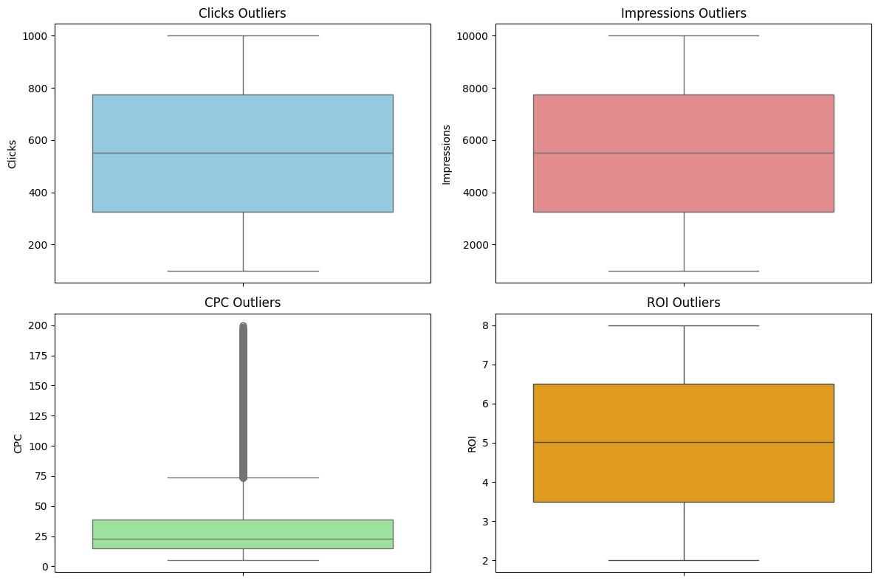
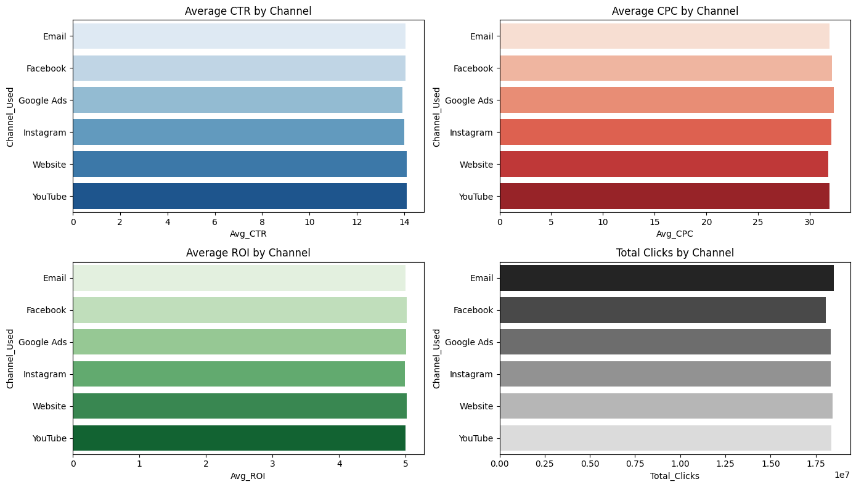
The graphics attached visually describe the presence of outliers in CPC and ROI.
These extreme values indicate campaigns that either spent too much with low returns or had unusually high returns. Identifying these helps optimize budget allocation and improve performance.
The graphics attached visually describe how different marketing channels perform based on CTR and conversion rates.
Social Media and Email Marketing show higher engagement, while Paid Search has a better conversion rate but higher CPC. This insight helps prioritize the most effective channels.

Slide 6
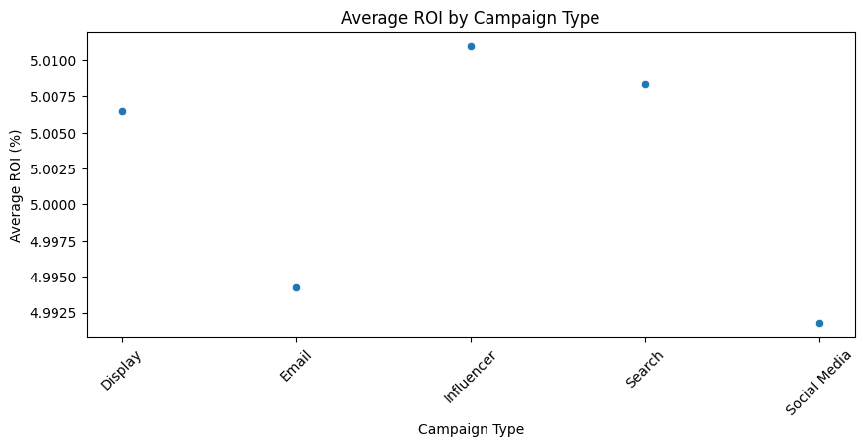
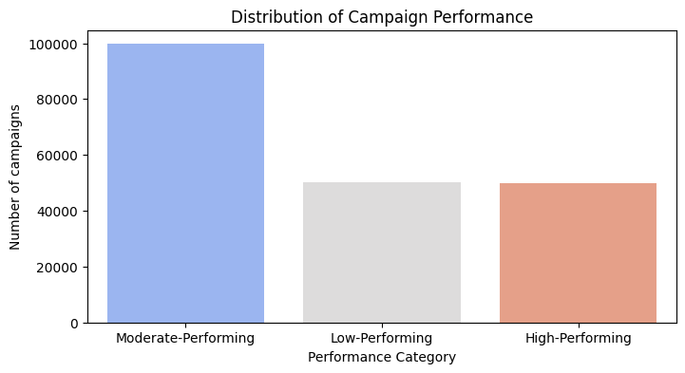
The graphics attached visually describe the ROI distribution across different campaign types.
Some campaign types yield significantly higher returns, while others struggle with profitability. Understanding this trend helps refine marketing strategies for better investments.
The graphics attached visually describe the distinction between high and low-performing campaigns based on ROI and CTR.
High performers have a balance of high CTR and low CPC, while low performers struggle with engagement and cost-effectiveness. This insight guides future campaign optimizations.

Slide 7
Recommendation
Conclusion
Data-driven insights help identify high-performing and underperforming campaigns.
ROI can be significantly improved by reallocating budgets to cost-effective channels.
Certain campaigns like social media require better targeting and ad creative optimization.
. Increase Budget Allocation for High-Performing Channels
✔ Invest more in channels with high CTR and lower CPC (e.g., Social Media and Email Marketing).
2. Reduce Spending on Underperforming Campaigns
✔ Campaigns with high CPC but low ROI should be re-evaluated or discontinued.
3. Optimize Targeting & Ad Creatives
✔ Use A/B testing to refine campaign messaging and audience targeting. ✔ Personalize content based on demographics and location trends.
4. Monitor Performance & Adjust Budgets in Real-Time
✔ Implement real-time tracking tools to optimize ad spend dynamically.

